Slide 1
Stroke Prediction project
Presented by :
Samer Wael

Slide 2
TABLE OF CONTENTS
01
02
03
04
05
06
ABOUT THE DISEASE
Business Overview
Our data
Introduction & More About Stroke
Problem Statement & Targeted People
Data Summary, Correlation and Understanding
Preprocessing
Ml models
CONCLUSIOn & Future Work
Data Cleaning Steps & Getting it Ready
Models Built & Testing Them to Select the Best Model
Summary, Save the model & Future Improvements

Slide 3
INTRODUCTION
According to the World Health Organization (WHO), Stroke is the 2nd leading cause of death globaally, responsible for approximately 11% of total deaths.
This dataset is used to predict wether a patient is likely to get stroke based on the input parameters as shown in a bit.

Slide 4
01
ABOUT THE DISEASE
Strokes are the 3rd leading cause of disability.
It is defined as the sudden death of some brain cells due to lack of oxygen.
The World Health Organizationn (WHO) declares strokes as one of the growing crises that is receiving very little attention to date. Early awareness of having this illness has proved to be beneficial for prevention and treatment.

Slide 5
Business overview
02
Problem Statement:
Strokes: Not the kind you find in a painting! 🎨
But the medical kind you definitely want to avoid!
Every year, millions of people around the world didn't predict they'd have a stroke... unfortunately, their health took them by surprise.
Can you predict the weather? 🌦️ Easy.
Predicting the next viral dance trend? 🕺 Also easy.
But predicting strokes? That’s where things get tricky... until now!
Our Goal: We want to use machine learning to make strokes as predictable as your best friend behavior .

Slide 6
Business overview
Targeted People:
Who’s in the danger zone? (Hint: it's not الرجل العناب)
Adults 40+
hypertensive people
Couch Potatoes
Statistically more at risk, but don't worry, we’ve got your back (and your brain 🧠)
Burger Lovers .. especially with a little too much salt .. (High blood pressure = high risk)
If you think your Netflix binge is a workout, your heart might disagree. ML will predict what your body’s been too lazy to tell!

Slide 7
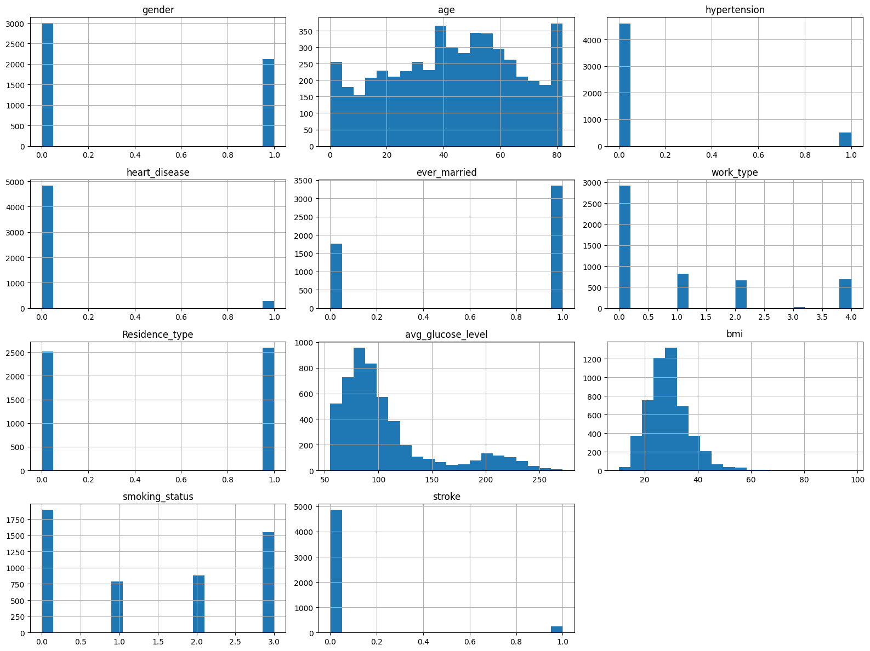

Our used data
Data Summary

Slide 8
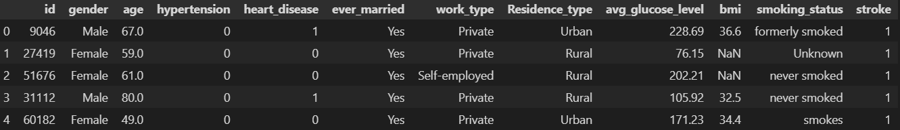
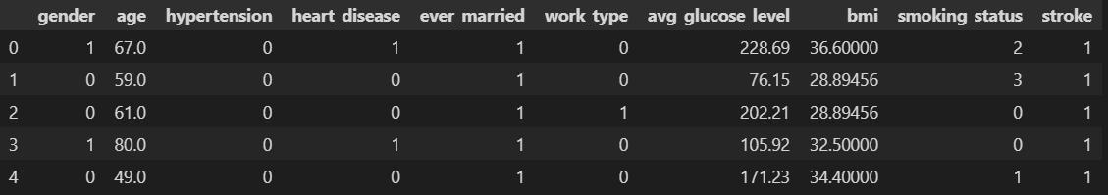
Our used data
Data Preprocessing
Before
After

Slide 9
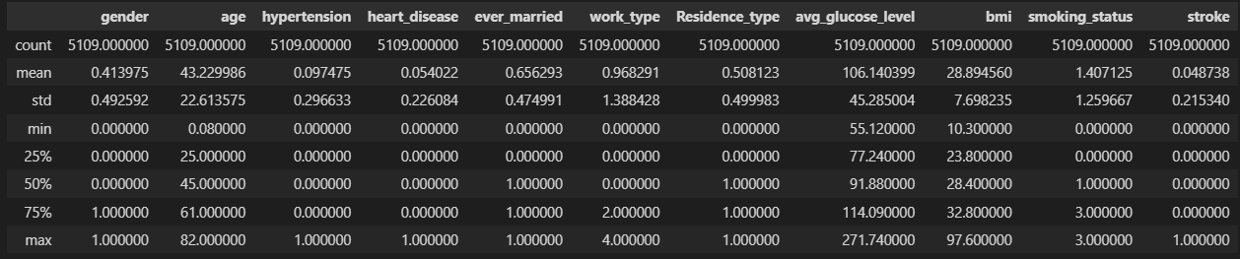
Our used data
Data Description

Slide 10
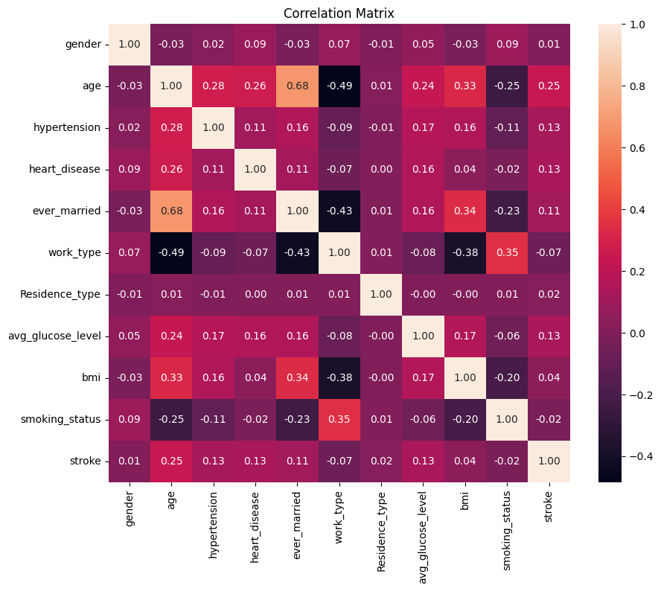
Data Correlation

Slide 11
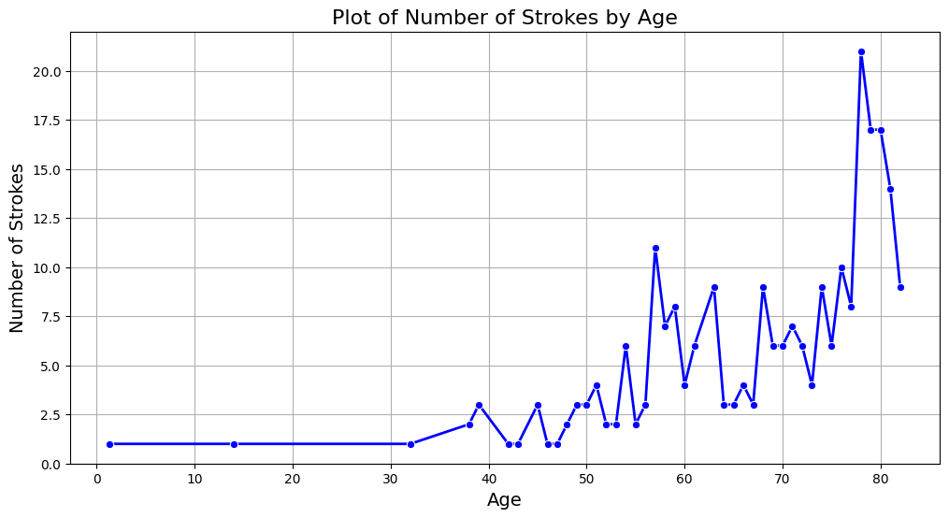
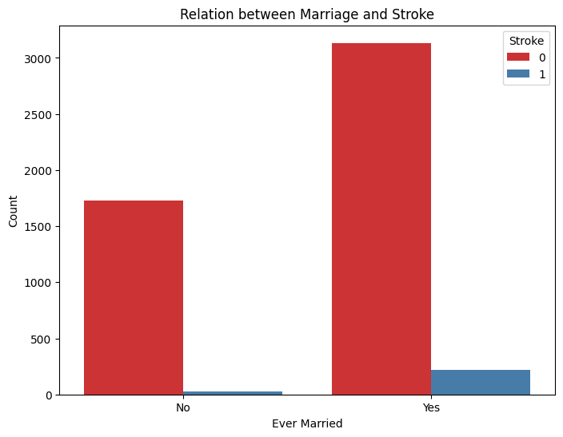
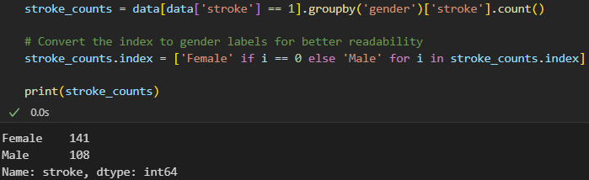
Data Correlation

Slide 13
Built ml Models

Slide 14
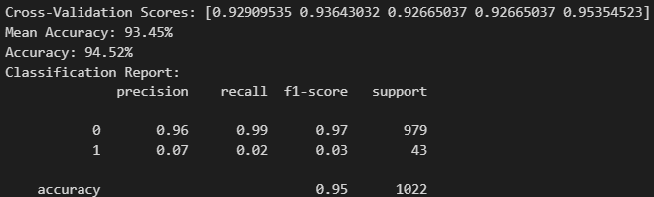
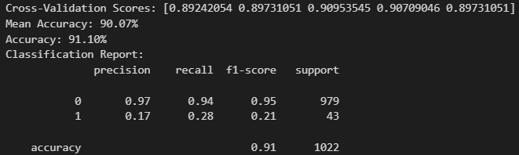
Built models
05
1. KNN Classification :
2. Decision Tree Classification :

Slide 15
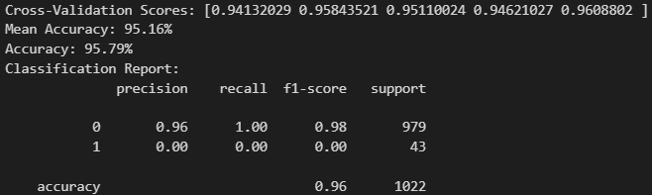
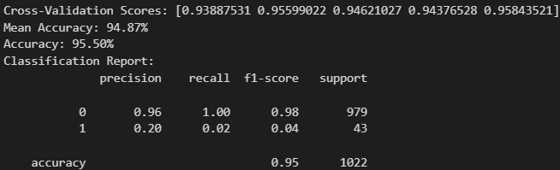
Built models
05
3. Logistic Regression :
4. Random Forest Classification :

Slide 16
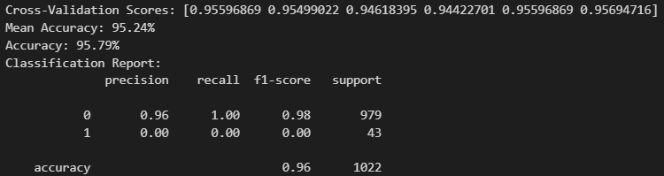
Built models
05
5. Support Vector Classification :

Slide 17
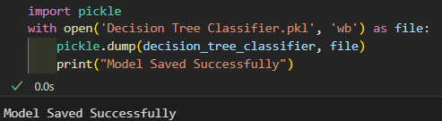
06
Summary
We can conclude that the Decision Tree Classifier is the best model because it has best evaluation metrics!
Let’s save our model :

Slide 18


06
Summary
To load our model again :
You can now use the loaded model to
make predictions For example:

Slide 19
Future improvements
06
Model Optimization
More Data,
More Power
Time for a model workout 💪 faster, better, stronger.
We’ll feed our model a data buffet. More data = smarter predictions!
User-Friendly Interface
Deal with unbalanced data
A little data makeover using SMOTE or whatever.
Turning our model into an app everyone can use because everyone deserves predictive power!

Slide 20

THANKS!
Do you have any questions? ❤️
Samer Wael
+20 155 456 3448
Samer.wael.2003@gmail.com

